Slide 2

Energy Test Habitat
Fluid Test Chamber
Psych Test Habitat
Wave Test Habitat
Grav Test Habitat

Slide 3




Slide 4
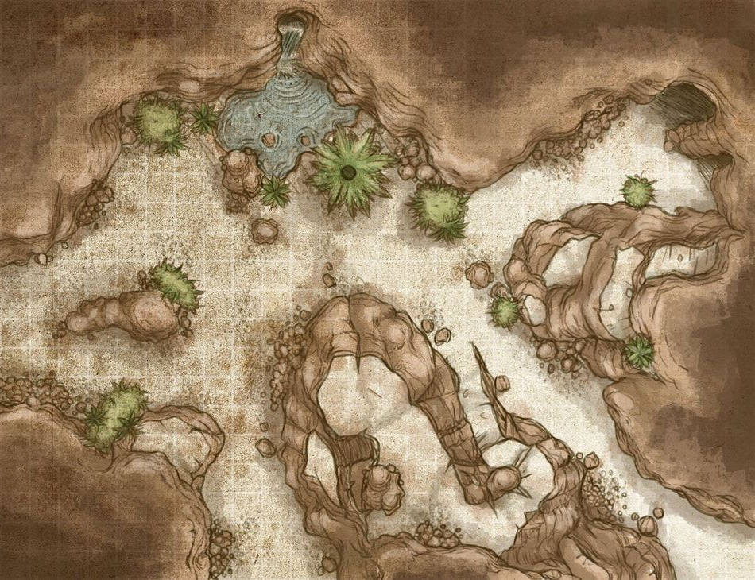
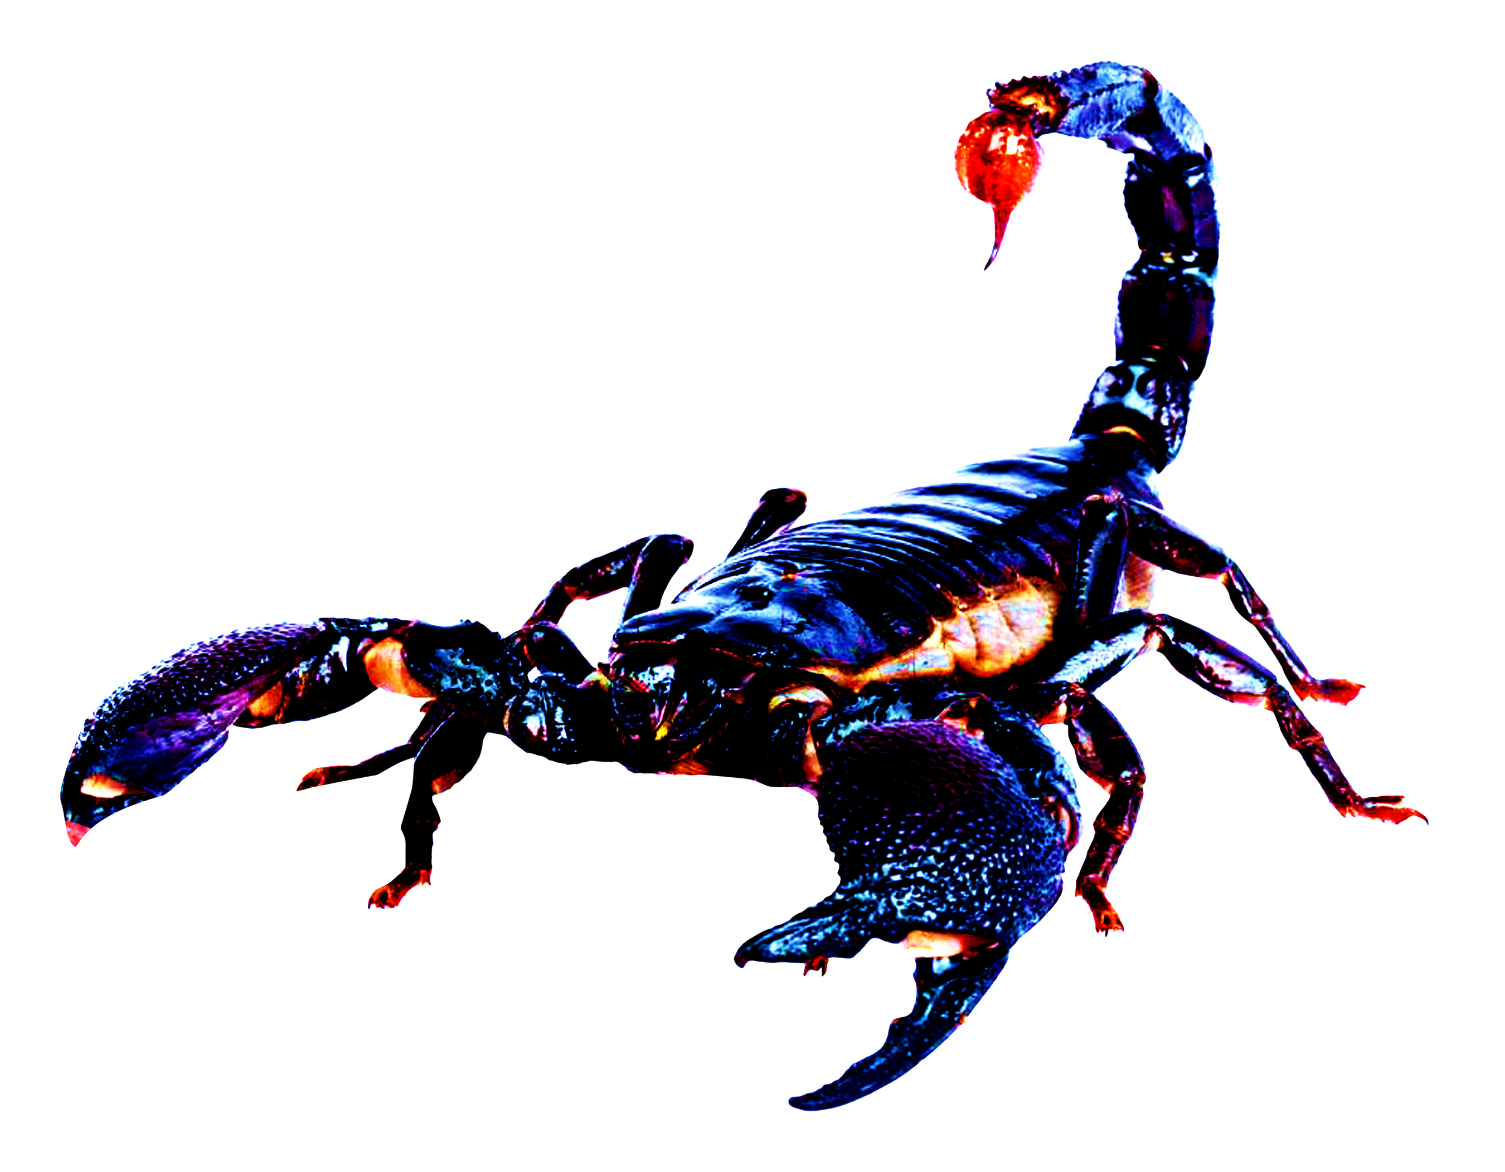
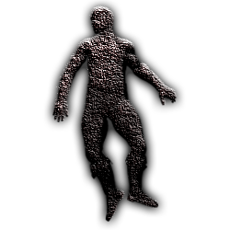

Slide 5
